Slide 1

The Role of Slag Cement in Creating Sulfate Resistance
www.SlagCement.org

Slide 2
Overview
What is Sulfate Attack?
Identifying Concrete and Environmental Risk Factors
Managing The Risk of Sulfate Attack In Concrete
Properties of Slag Cement - Benefits in Mitigating Sulfate Attack
Example of a Concrete Field Exposure Site

Slide 3

What Is Sulfate Attack?
The term used to describe a series of chemical or physical reactions between sulfate ions and the components of hardened concrete, principally the cement paste, caused by exposure of concrete to sulfates and moisture.
Skalny, et al. 2002
In Other Words
If all of these conditions are met in substantial quantity, there is a risk for Sulfate Attack
Sulfate Ions
Water
C₃A & CaOH
Accessibility To Paste
Chemical Sulfate Attack
Sulfate Ions
Water
Absorption Into Concrete
Wetting / Drying Action
Physical Sulfate Attack
Is this oversimplification?

Slide 4

Types of Sulfate Attack
Chemical
Physical
Also referred to as
classical sulfate attack
Also referred to as
salt crystallization
Sulfate reacts with hydration product of C₃A and CaOH forming ettringite
Tends to occur in arid zones
e.g. Western U.S. / Canada
Wicking of sodium sulfate and water into concrete followed by wetting and drying action
Ettringite expands to causing distress in hardened concrete

Slide 5
Sources of Sulfate
Internal
External
Source of Sulfate contained in mixed concrete
Source of Sulfate supplied from external source
Excess sulfate in cement / SCMs
Sulfate rich aggregate
Contamination
Sea, brackish & ground water
Wastewater
High sulfate soils
Examples:
Classic ettringite attack
DEF (special case)
Examples:
Classic ettringite attack
Salt crystallization
Thaumasite

Slide 6
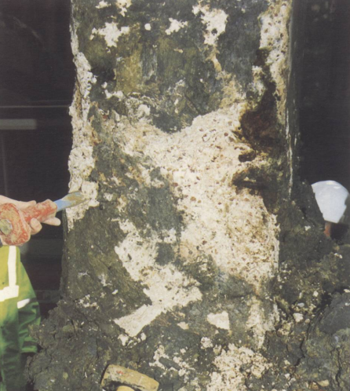
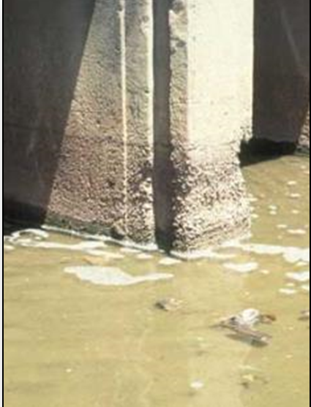
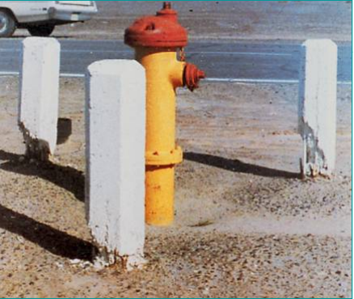

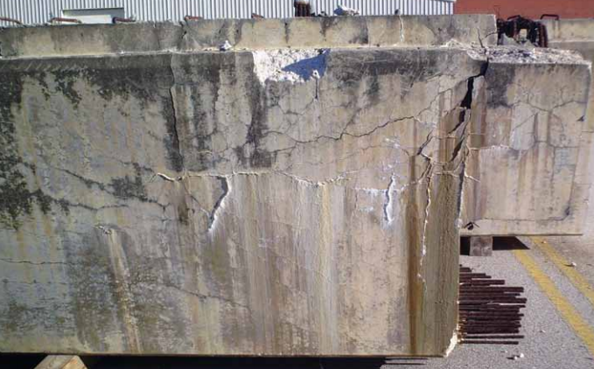
What Does Sulfate Attack Look Like?
Physical
Thaumasite
Chemical
DEF / ASR

Slide 7
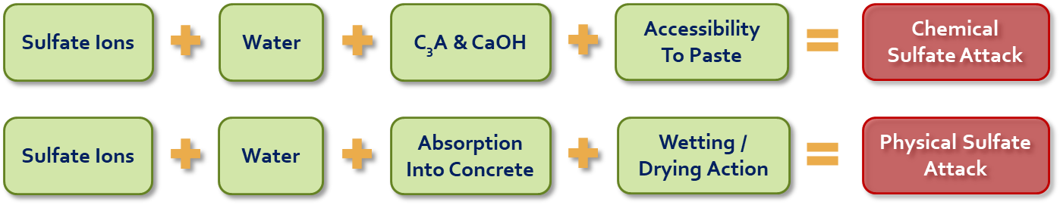
Identifying Risk for Sulfate Attack
Understand the source and quantity of sulfate in the environment

Slide 8
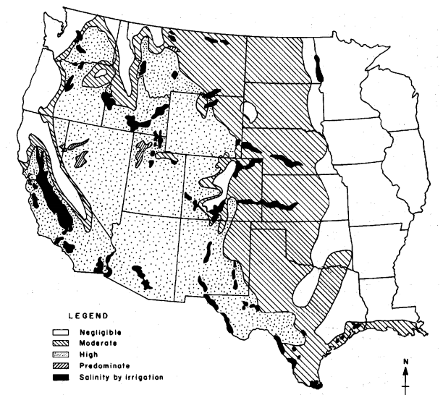
Sulfate In Soils and Water
From ACI 318 – Building Code
Exposure Category | Sulfates In Soil (% by Mass) | Sulfates In Water (ppm)
S0 | < 0.10 | < 150
S1 | 0.10 – 0.20 | 150 – 1500 & seawater
S2 | 0.20 – 2.00 | < 1500 – 10,000
S3 | > 2.00 | > 10,000
All Seawater is designated category S1?

Slide 9
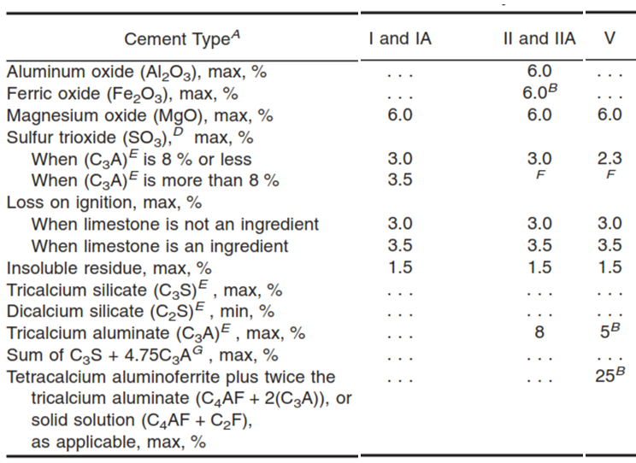
Sulfate Exposure Class of Sea Water
Question
Why is all seawater designated exposure class S1?
Especially when seawater sulfate levels vary substantially by location
Answer
Higher exposure classes steer specifier toward Type V and HS cement (lower C₃A)
Corrosion of steel is a bigger problem & C₃A slow ingress of chlorides through binding

Slide 10
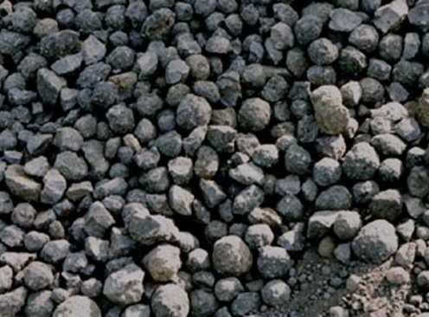
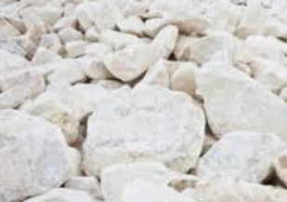
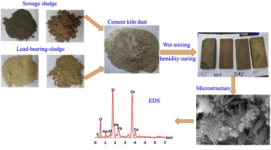
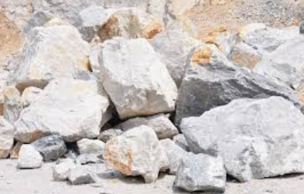
Composition of Portland Cement
Standard portland cement types
  Type I
  Type II
  Type II(MH)
  Type III
  Type IV
  Type V
  General use
  Moderate sulfate resistance
  Moderate sulfate & Moderate Heat
  High early strength
  Low heat of hydration
  High sulfate resistance
Each type intended to address a specific performance or durability characteristic
Portland Cement
Clinker (91.4%)
Gypsum (5.2%)
IPA (>1%)
Limestone (2.7%)
Source: Portland Cement Association’s 2021 Portland Cement EPD

Slide 11
Blended Hydraulic Cement
Blended cement types
Designations for special properties
  Portland blast-furnace slag cement
  Portland-pozzolan cement
  Portland-limestone cement
  Ternary blended cement
  Moderate sulfate resistance
  High sulfate resistance
  High early strength
  Moderate heat of hydration
  Low heat of hydration
  Air entraining is required
  Type IS
  Type IP
  Type IL
  Type IT
  (MS)
  (HS)
  (HE)
  (MH)
  (LH)
  (A)
Each type indicates the cement composition
Type IL Cement
Clinker (82.7%)
Gypsum (5.7%)
IPA (>1%)
Limestone (10.8%)
Source: Portland Cement Association’s 2021 Portland-Limestone Cement EPD
Notes:
Portland-limestone blended cement composition example

Slide 12
Blended Hydraulic Cement – Naming Practice
  Type IS(60)(LH)
  Type IL(10)
  Type IL(12)(MS)
  Type IT(L10)(S40)(HS)
Portland Cement
Moderate Sulfate Resistance
Portland Cement
Portland Cement
Portland Cement
Blended With Limestone & Slag
Blended With Limestone
Low Heat
Blended With Slag
10% Limestone Target
10% Limestone Target
12% Limestone Target
Blended With Limestone
60% Slag Target
40% Slag Target
High Sulfate Resistance
In ternary blends component designations are listed alphabetically

Slide 13
Identifying Risk for Sulfate Attack
Understand vulnerabilities of concrete mixture to sulfate attack
Utilize established guidelines and or laboratory evaluation of mix design and constituents

Slide 14
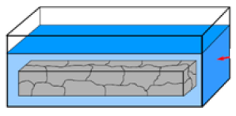
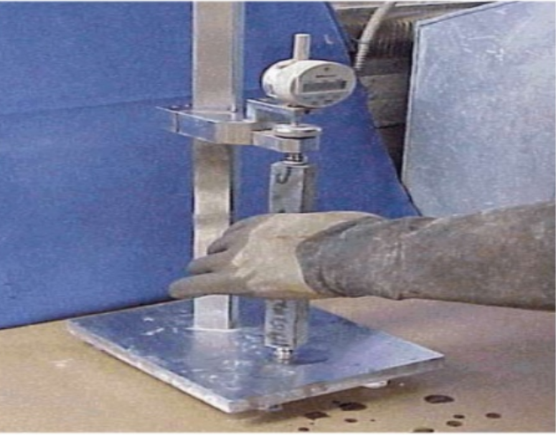
Evaluating Cement and SCM’s – ASTM C1012
Test summary
Used to evaluate sulfate exposures (expansion) of combinations of Portland & blended cement, pozzolan, and slag cement
Mortar bar test with fixed W/C ratios
Air entrained concrete: 0.460
Non air entrained concrete: 0.485
Mortar bars stored in Na₂SO₄ solution and measured for length change over time (6 to 18 months)

Slide 15
Interpreting C1012 Results
Exp. Class | Max w/cm | Min f’_{c} psi | Cementing Materials | Performance Requirements in ASTM C1012 (max %)
 |  |  |  | 6 m | 12 m | 18 m
S0 | No Requirements
S1 | 0.55 | 3500 | Performance test only → | 0.05 | 0.10 | -
 | 0.50 | 4000 | Type II or Type MS blended cements | 0.10 | - | -
 | 0.45 | 4500 | No restriction | - | - | -
S2 | 0.50 | 4000 | Performance test only → | - | 0.05 | 0.10
 | 0.45 | 4500 | Type V or HS-designated cements | 0.05 | 0.10 | -
 | 0.40 | 5000 | Type II or Type MS | 0.10 | - | -
S3 | 0.45 | 4500 | Performance test only → | - | 0.05 | 0.10
 | 0.40 | 5000 | Type V or HS designated cements | 0.05 | 0.10 | -

Slide 16
Managing The Risk of Sulfate Attack
Preventative Measures
Utilize Type II & V cement or Type MS & HS blended cement to reduce C3A available to attack
Reduce cement C3A content
Reduction of paste permeability
Lower W/Cm ratio, SCMs, adequate curing can greatly reduces ability of sulfates to penetrate into concrete
Use SCMs at suitable replacements
SCMs like slag cement, Class F ash, silica fume contribute to reduction of overall C3A, permeability and utilize excess CaOH

Slide 17
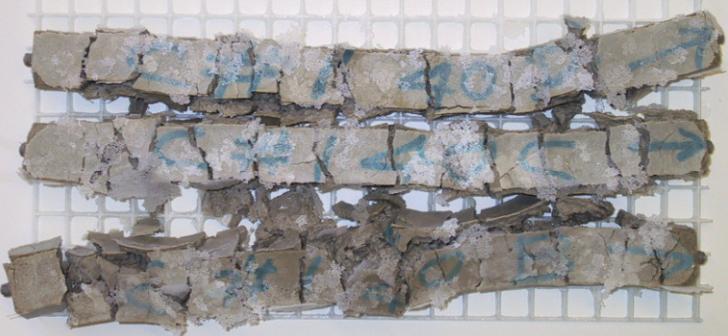

All SCMS Are Beneficial To Mitigate Sulfate Attack, Right?
Not So Fast!

Slide 18
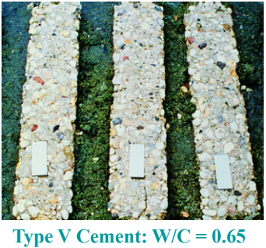
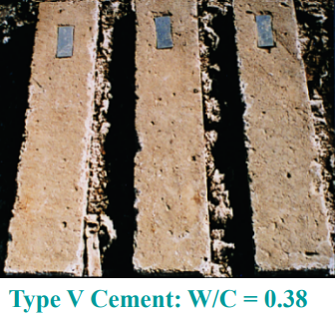
W/C Ratio and Sulfate Attack Resistance
Samples after 12 years
Stark PCA, Sacramento Site 1990
W/Cm Ratio plays a big role in reduction of permeability

Slide 19
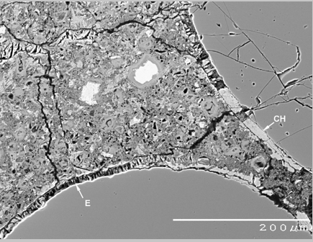
Delayed Ettringite Formation
A special case of internal sulfate attack
Formation of ettringite at late ages due to elevated curing temperatures in excess of 158 f (70 c) at early ages
Formation of late age ettringite can cause expansion and cracking and ultimately deterioration of concrete
If sufficient SCMs used, early age temperatures up to 185 f (85 c) are acceptable – ACI 201.2R-16
Ramlochan 2003
Occasionally associated with alkali silica reaction ASR

Slide 20

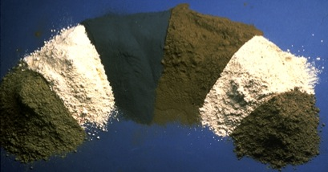
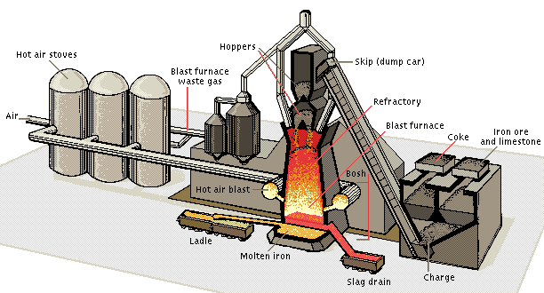
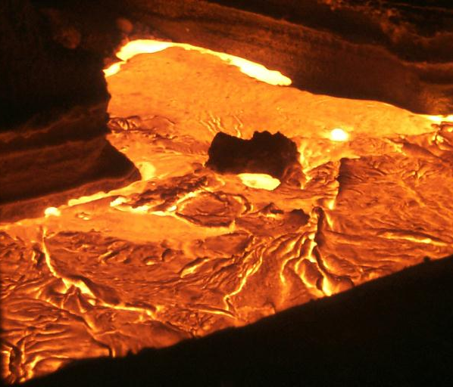
What Is Slag Cement?
A fine white powder that can be used as a SCM to enhance the properties of concrete
In the presence of moisture exhibits hydraulic properties similar to portland cement
Where does it come from?
Non-metallic molten material (slag) is diverted from the waste stream of iron ore blast furnace
Rapidly quenched to produce a glassy granulated product
Slag
Cement
Slag

Slide 21
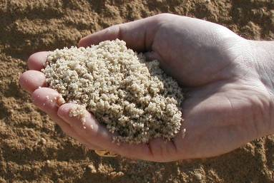
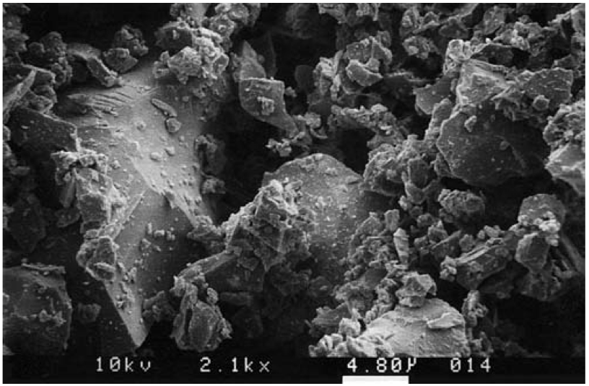
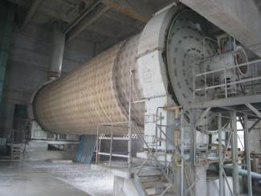
What Is Slag Cement?
Granules are ground to a suitable fineness
Typically finer than portland cement
Can be used in concrete mixtures to enhance durability and sustainability
Slag Granules
Microscopic View Of Slag Cement
Slag Cement Grinding Facility

Slide 22
Slag Cement Reaction
CSH
Voids
and
CaOH
Aggregate
Aggregate
Portland Cement
Slag Cement
Portland Cement
Concrete System
Portland-Slag Cement
Concrete System
Notes:
Schematically, the picture on the left shows what happens when ordinary portland cement (gray) hydrates. Calcium-silicate hydrate is formed (yellow), but there are significant areas where this “glue” is not present (voids).
The picture on the right shows that with slag cement (white), much more of the paste is filled with the Calcium Silicate Hydrate. The volume of voids is significantly reduced.
The increased formation of calcium silicate hydrate gives concrete made with slag cement more strength and reduces its permeability.
Greater bond is also formed with the aggregate particles, thus enhancing strength, particularly tensile/flexural strength. (Check Seattle presentation data on flexural strength info)

Slide 23

Reduced Permeability
What is permeability?
  Measure of how easy it is for water, air and other substances such as chloride ions to enter concrete
  Commonly measured by ASTM C1202 Test Method for Rapid Chloride Permeability
Why is it important?
  Low permeability concrete can reduce corrosion potential of embedded reinforcing steel
How does slag cement affect permeability?
  Slag cement reacts with calcium hydroxide CaOH to create calcium silicate hydrate CSH reducing permeability
  Low permeability can be achieved in binary and ternary systems with 25 to 65% replacement rates

Slide 24
Effect of Slag Cement on Sulfate Resistance

Slide 25
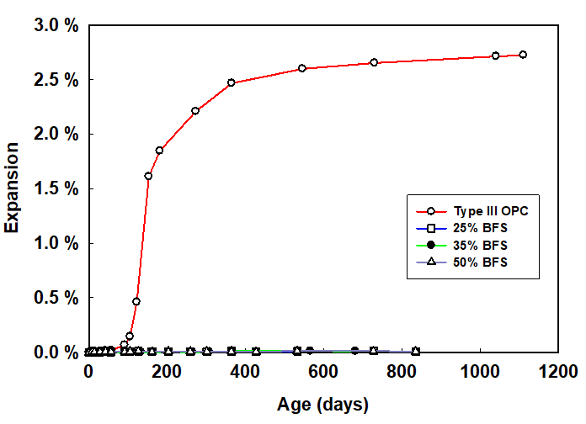
Slag Cement and Delayed Ettringite Formation
Type III with 0-50% slag cement replacement cured at 203 f (95 c)
Samples cured at 203 f (95 c) initially then stored in water for 2.5 years
Deleterious expansion > 0.10%
As little as 25% slag cement completely eliminated DEF
Ramlochan 2003

Slide 26
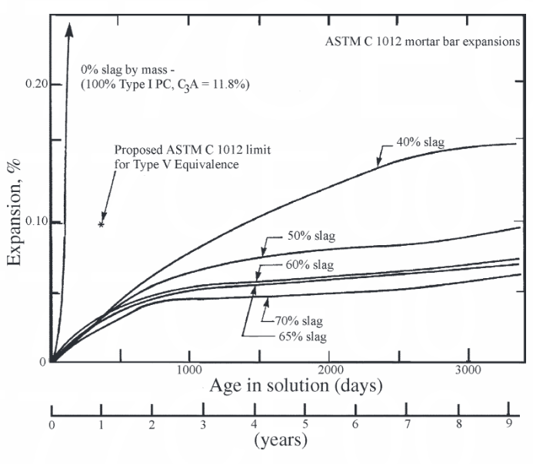

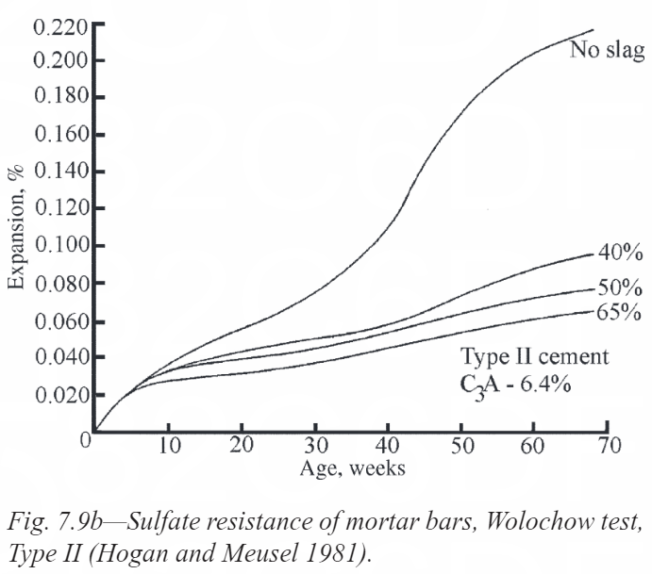

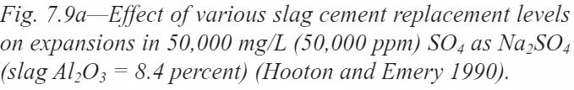
ACI 233R-17
Guide to the Use of Slag Cement in Concrete and Mortar
Type I Cement (C3A = 11.8%) and
various slag cement replacement
Type II Cement and
various slag cement replacement

Slide 27
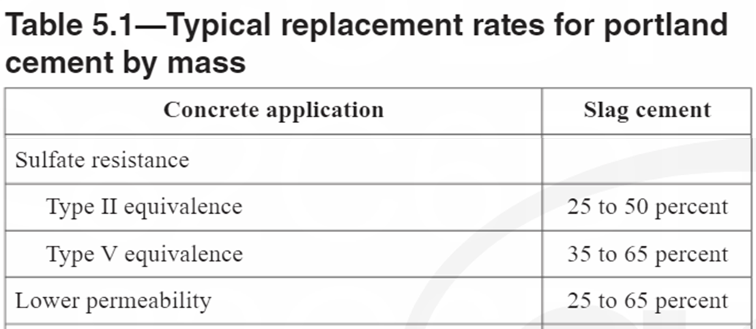
ACI 233R-17
Guide to the Use of Slag Cement in Concrete and Mortar
Require high sulfate resistance but limited on low C3A cement?

Slide 28
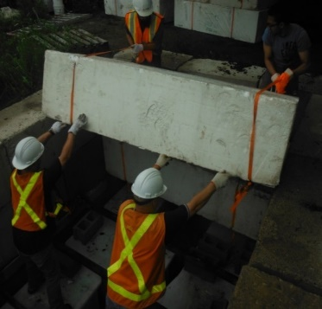
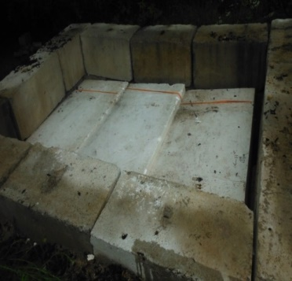
Toronto: Concrete Field Sulfate Exposure site
Slag Cement mitigating Sulfate Attack in the Field
2010: trench 8 ft deep prepared for exposure site
Variable annual temperature of 37-61 degrees f.
Test Specimens were concrete prisms 3x 3x 11 in.
Na₂SO₄ (sodium sulfate) concentration 15,000 ppm
Numerous mixture combinations tested
Type IL(10.5) blended cement with 40 & 50% slag cement
  Type IL C3A = 11%
Type V (high sulfate resistance) without SCM
0.40 Water to Cementitious Ratio

Slide 29
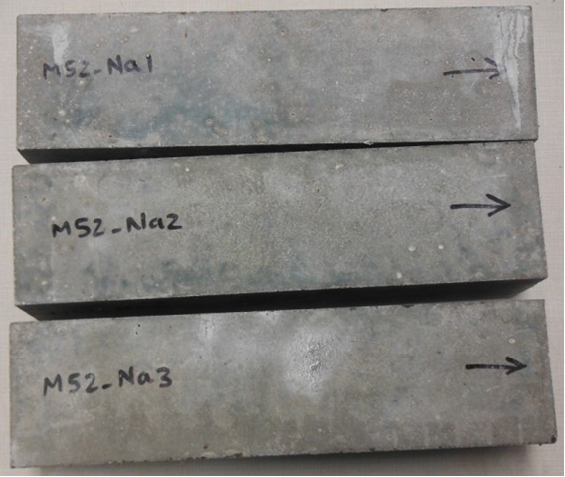
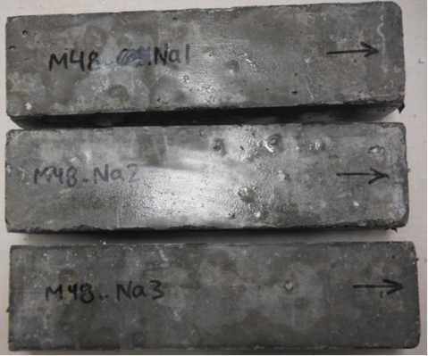
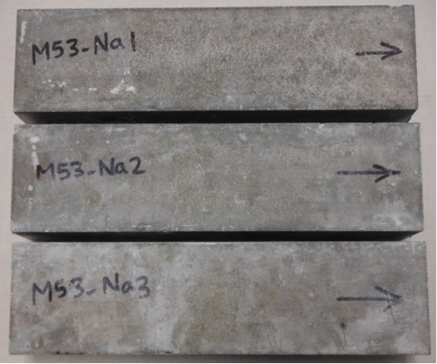
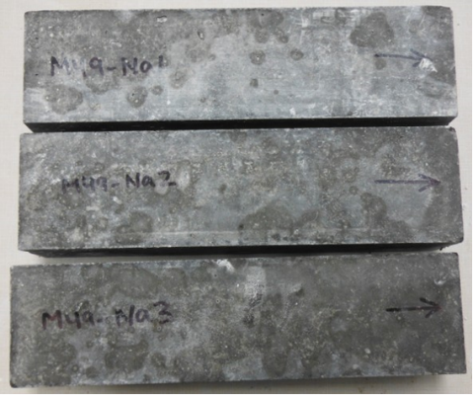
Slag Cement mitigating Sulfate Attack in the Field
C595 Type IL(10.5) + 40% Slag
C150 Type V (2)
33 months later…
Type IL with 40% slag cement comparable to Type V cement
Type IL with 50% slag cement showing better performance to Type V cement
Minor damage
Minor damage
C595 Type IL(10.5) + 50% Slag
C150 Type V (2)
Excellent Condition
Minor damage

Slide 30
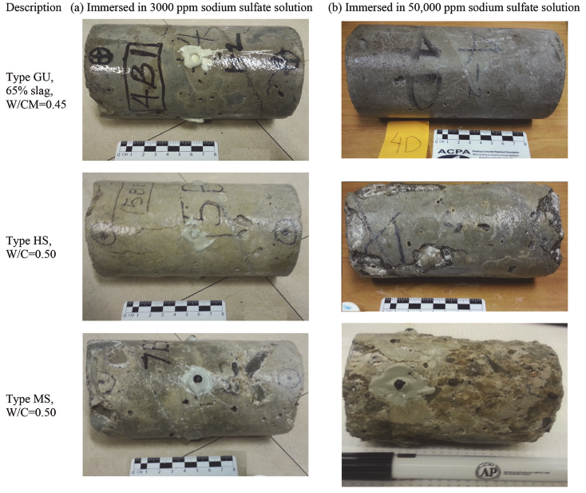
Slag Cement mitigating Sulfate Attack
How about 38 years of sulfate exposure?
Laboratory example of long-term exposure
Alapour & Hooton, 2017

Slide 31
Questions?

Slide 32


