Slide 1
Upcoming Webinars
Geotechnical Applications with Slag Cement, Gordon McLellan, Lehigh Hanson, March 18, 1 p.m. EST;
Slag Cement Award Ceremony 2020 Winners, Drew Burns, Executive Director, SCA, April 15, 1 p.m. EST; and
Slag Cement Research Awards Presentations, April 29, 1 p.m. EST.
On-Demand Webinars (slagcement.org/resources/webinars)
Improving Concrete Performance with Slag Cement
Demonstrating Low-Carbon and Resilient benefits of Concrete with Slag Cement
Mitigating Alkali Silica Reaction in Concrete with Slag Cement
The Role of Slag Cement in Creating Sulfate Resistant Concrete

Slide 2
Geotechnical Applications with Slag Cement
Gordon McLellan, Lehigh Hanson
3.18.2021 1PM EST

Slide 3
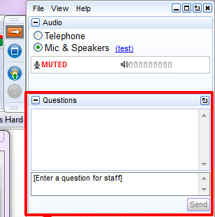
Presentation Notes
Find presentation slides and post event recording at: slagcement.org/videos
Listen only mode.
Ask questions in the dialog box in GoToWebinar

Slide 4
Disclaimer
As with all concrete mixtures, trial batches should be performed to verify concrete properties. Results may vary due to a variety of circumstances, including temperature and mixture components, among other things.
You should consult your slag cement professional for assistance. Nothing contained herein shall be considered or construed as a warranty or guarantee, either expressed or implied, including any warranty of fitness for a particular purpose.

Slide 5
Learning Objectives
The presentation will provide information on how slag cement can be used in soil stabilization projects. The design process, standard design criteria, laboratory testing examples, and field test case studies will all be covered in this presentation.

Slide 6
Gordon McLellan
Gordon McLellan is Technical Manager at Lehigh Hanson’s slag facility in Cape Canaveral, Florida. He has been involved in the development and growth of Slag Cement, formally known as Ground Granulated Blast Furnace Slag (GGBFS,) in North America for twenty-eight years. After Queen’s University (BSc Eng), he worked with Koch Minerals, in Sudbury, Ontario, Canada developing applications using Slag cement in mining backfill and geo technical applications in heavy construction. As a Product Manager for Holcim in both Slag and Fly ash, where he started in in Chicago IL in 1993, he continued promoting the use of slag cement in concrete applications. Gordon is now living in Cape Canaveral Florida with his wife Cheryl, where he joined Civil and Marine in 2003, during design and development of the Cape Canaveral Slag Facility. As the Technical Manager, he oversaw product development, then Sales and Marketing. The Cape Canaveral slag facility was later acquired by Hanson PLC and became part of Lehigh Hanson, Inc. following HeidelbergCement’s acquisition of Hanson PLC in 2007.

Slide 7
Slag Cement in Geotechnical Projects Thursday March 11/2021 Gordon McLellan Lehigh Hanson
Notes:
7

Slide 8
Slag Growth in the USA

Slide 9
Where Slag Cement Comes From – The Blast Furnace

Slide 10
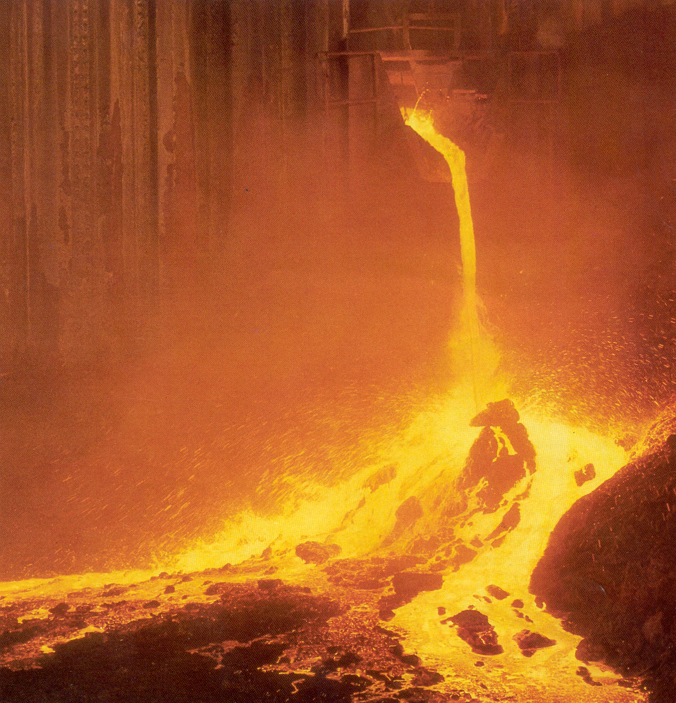
Notes:
The slag is initially diverted into a pit because it may have a small amount of iron in it. This slag is air cooled and becomes aggregate, usually used as a base material for roadways.
(If slag contaminated with iron is granulated, hydrogen gas is produced and may cause an explosion. That is why the slag is initially diverted.)

Slide 11
Notes:
Molten slag that becomes slag cement is sent to a granulator.
The slag at this point is about 2,500 degrees F.
The granulator quenches the slag with large amounts of water—at about a 100 to 1 ratio of water to slag or about 50 tons of water a minute—reducing the temperature to 170 degrees in less than 1 second.
The rapid cooing “freezes” the slag in a glassy state because the slag is not able to form crystals as it does during the slow air-drying process.
The glassy, non-crystalline nature of the slag is what imparts its cementitious properties once it is ground to a fine powder.
However, before it is ground, the solid slag emerging from the granulator is called “granules,” and is the texture and color of a coarse sand.

Slide 12
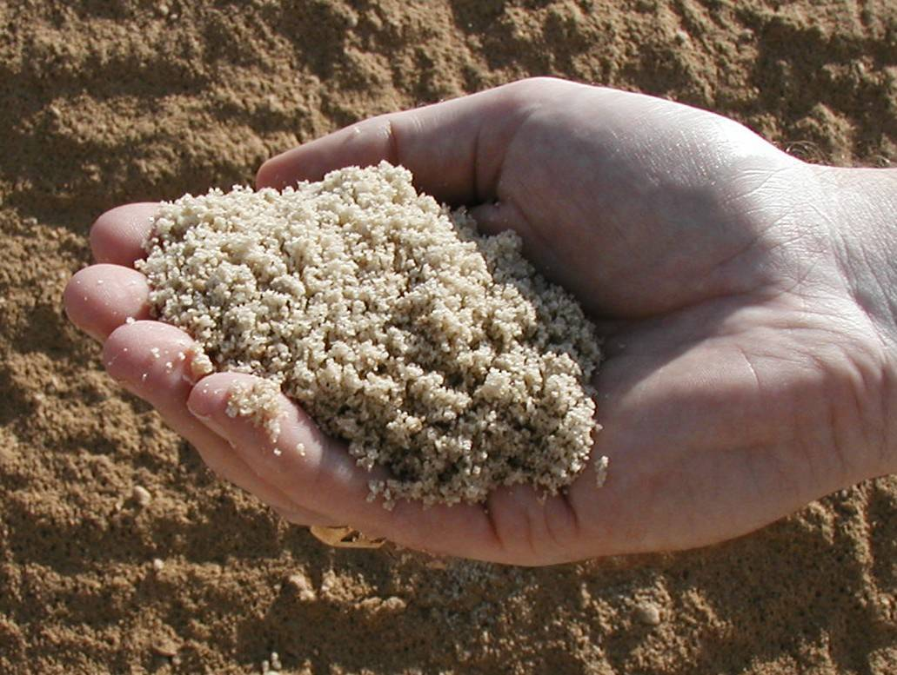
Notes:
These are slag granules taken from the stockpile.
They look like coarse sand, but are actually glassy particles.
Granules are analogous to cement clinker after the clinker leaves the kiln, but prior to grinding. Slag granules do not weather like cement clinker. Slag granules can be exposed to moisture for years without seriously affecting strength.

Slide 13
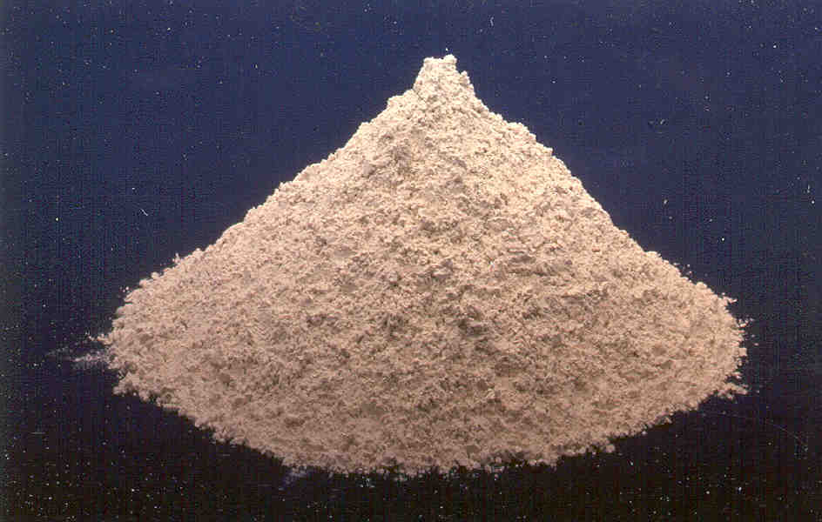
Notes:
Slag cement, the finished product, is a light powder, normally ground finer than portland cement.

Slide 14
What are differences between PC and Slag
Portland Cement is typically manufactured with the use of kiln requiring some virgin materials and high heat to produce clinker which is then ground into cement versus slag cement being manufactured with recycled or waste material – uses less energy and has no carbon associated with it
Slag at 50% has higher compressive strength
Far lower permeability

Slide 15
Geotechnical considerations
PSI per pound of cementitious – Slag Cement is more hydraulic, particularly in lower amounts and at higher water cement ratios than Portland cement.
Therefore as strength requirements lower, slag has more defined effect than Portland cement and is used at higher replacements (>70%) requiring less total cementitious
Less Toxic – TCLP
Has the ability to tie up heavy metals similar or higher compared to Portland cement
Much lower Permeability than PC by itself

Slide 16
Slag Cement in contact with Groundwater - TCLP Data
The TCLP, or Toxicity Characteristic Leaching (not Leachate) Procedure is designed to determine the mobility of both organic and inorganic analytes present in liquid, solid, and multiphasic wastes. This is usually used to determine if a waste may meet the definition of EP Toxicity, that is, carrying a hazardous waste code under RCRA (40 CFR Part 261) of D004 through D052.

Slide 17
Typical TCLP DATA
TCLP
Element | Results | LIMIT | Detection Limit
 | mg/L | mg/L | mg/L
ARSENIC (As) | N/D < .04 | 5 | .04
BARIUM (Ba) | 0.04 | 100 | 0.01
CADMIUM (Cd) | N/D < .01 | 1 | .01
CHROMIUM (Cr III,VI) | N/D < .01 | 5 | 0.01
LEAD (Pb) | N/D < .03 | 5 | 0.03
SELENIUM (Se) | N/D < .07 | 1 | 0.07

Slide 18
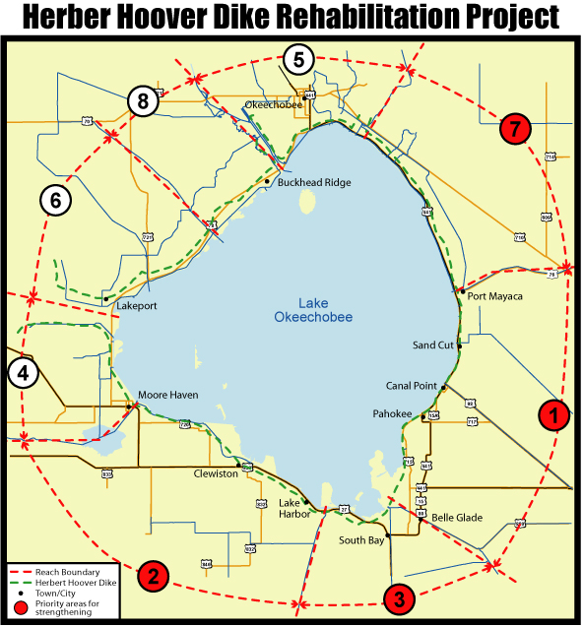
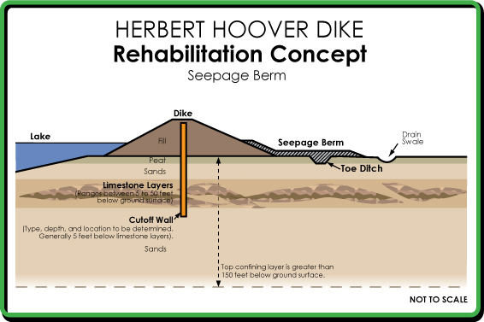
Project 1 - HHD – Cutoff Wall (Low Permeability)

Slide 19
HHD
Is the 2nd largest fresh water lake in the USA at 730 square miles. It is contained by a dike system started in 1937 and which was last upgraded in 1960. It now consists of 143 miles .
In 2006 US Corps of Engineers had awarded three, $250 million contracts totaling three quarters of a billion dollar to construct a cut off wall through center of dike. Hayward Baker, Bauer and Trevi Icos were each awarded a $250 million contracts. Currently project is continuing and will be finished by 2022 with TO1, TO3, TO5 being awarded to Bauer and TO2, TO4 being awarded to Trevi
All contractors used Slag Cement at between 75 and 80% due to required strength (500psi) and permeability requirements.

Slide 21
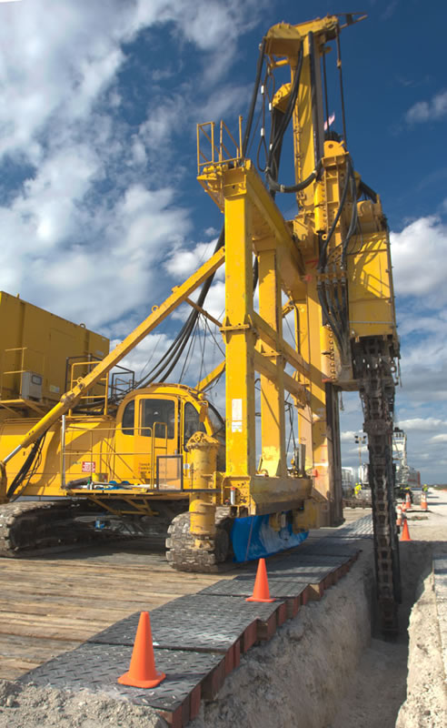
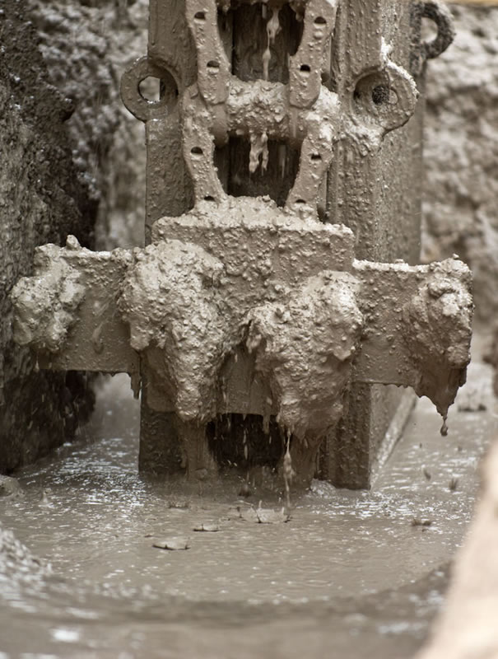
In Situ Mixing

Slide 22
Slurry Modeling

Slide 23
100% GGBFS or Slag Cement

Slide 24
Project 2 - Miami Access Tunnel (Controlled Strength)

Slide 25
Miami Access Tunnel
70% Lehigh Slag being used in Shallow soil mixing
50% Lehigh Slag being used in Precast tunnel Lining

Slide 26
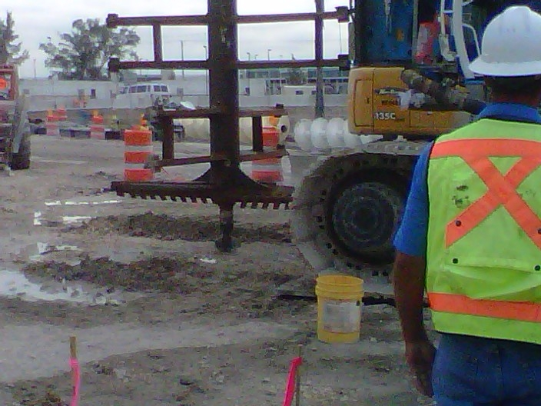
Shallow Soil Mixing

Slide 28
Back to Geotechnical Considerations

Slide 29
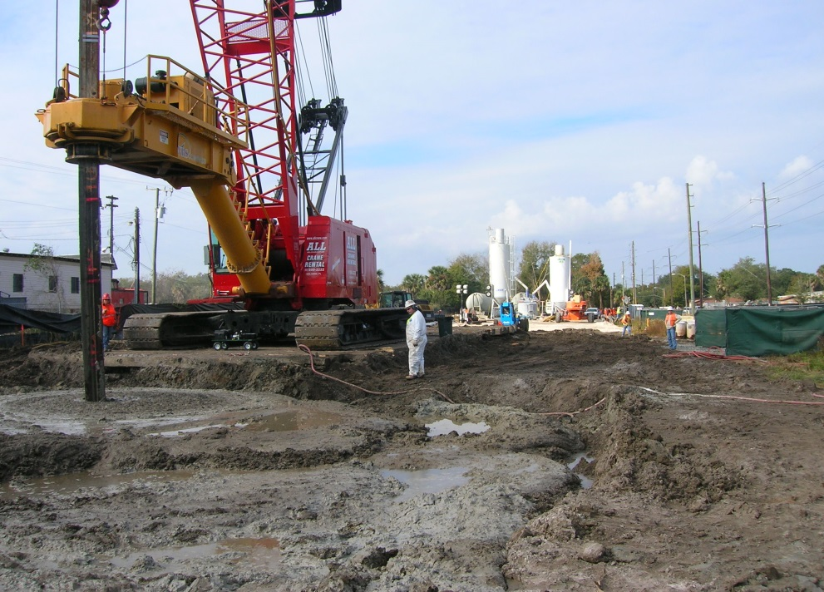
Project 3 - Sanford Gasification Project (TCLP)
For the Sanford, FL Gasification Plant Superfund Project. Slag was selected as the major cementitious component for the project due to its ability to bind heavy metals in situ and Lehigh Slag Cement superior performance in environmental tests such as TCLP which demonstrates that no additional toxic materials leach into the environment.

Slide 30
Project 4 - Jade Signature
Deep Soil Mixing – 13,000 tons of Lehigh Slag used at 80 – 90% with 20 -10% portland
Mass concrete specified at 10,000 psi @ 9800 cubic yards, 60% Lehigh Slag with total cementitious of 1,040 lbs
In the superstructure, 99% of all concrete contains slag from 3000 psi to 8500 psi with Lehigh Slag used at between 50 and 60%.

Slide 31
Jade Signature

Slide 32
Underground Mine Fill

Slide 34
90% slag cement

Slide 35
Thank You
QUESTIONS?

