Slide 1
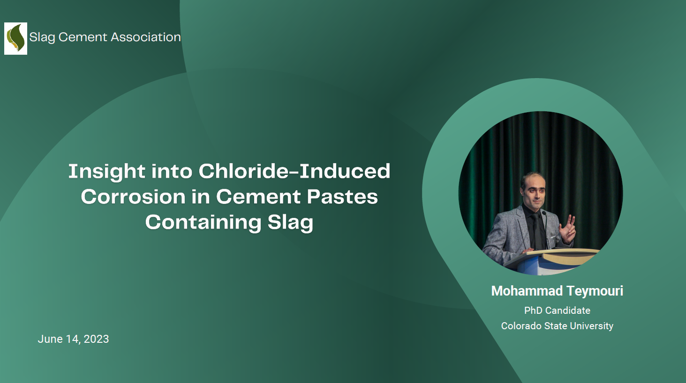

Slide 2
Acknowledgment
My advisor: Professor Mahmoud Shakouri
The Slag Cement Association for the opportunity.

Slide 3
Table of Contents
Introduction
Background
Literature Review
Problem Statement
Objectives
Methodology
Materials
Sample Preparation
Test Procedures
Conclusion
Results
Chloride Binding
Chloride Desorption
Analytical Tests
Main Findings
Proposed Mechanism
Limitations
Future Works

Slide 4
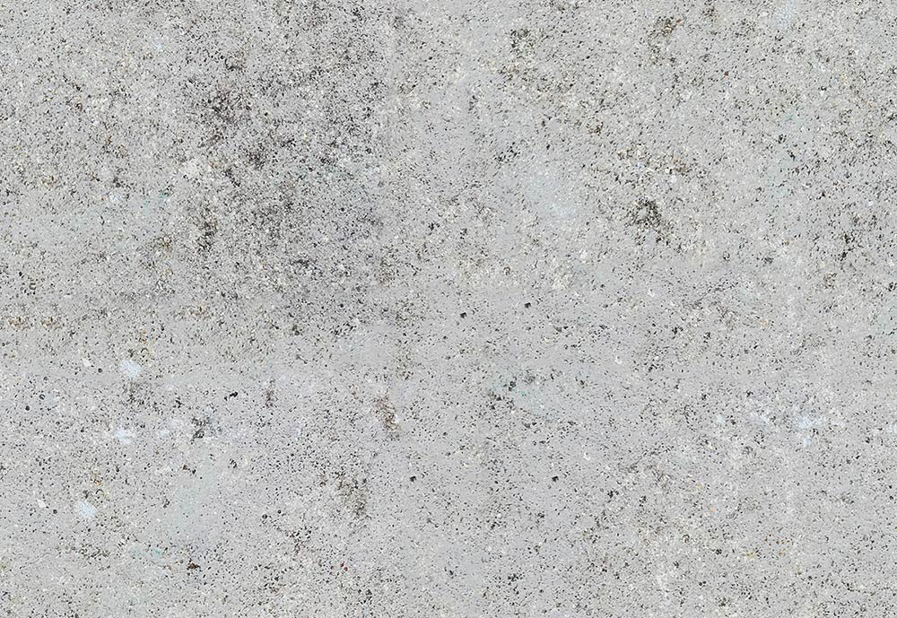
What is Chloride Attack?
Cl⁻
Cl⁻
Cl⁻
Cl⁻
Cl⁻
The “passive layer” remains intact as long as:
pH > 12 or Chloride ions are not present!
Cl⁻
Cl⁻
Cl⁻
Cl⁻
Cl⁻
Cl⁻
Cl⁻
Cl⁻
Cl⁻
Cl⁻
Cl⁻
Cl⁻
Cl⁻
Cl⁻
Cl⁻
Cl⁻
“passive layer” forms due to presence of OH- (high pH) in concrete pore solution
Chlorides breaks down the “passive layer” around reinforcing bars.
The rebars loses section during corrosion, losing capacity!
The corrosion products (black rust and red rust) are 2x to 3x more volumes, causing more cracking!

Slide 5
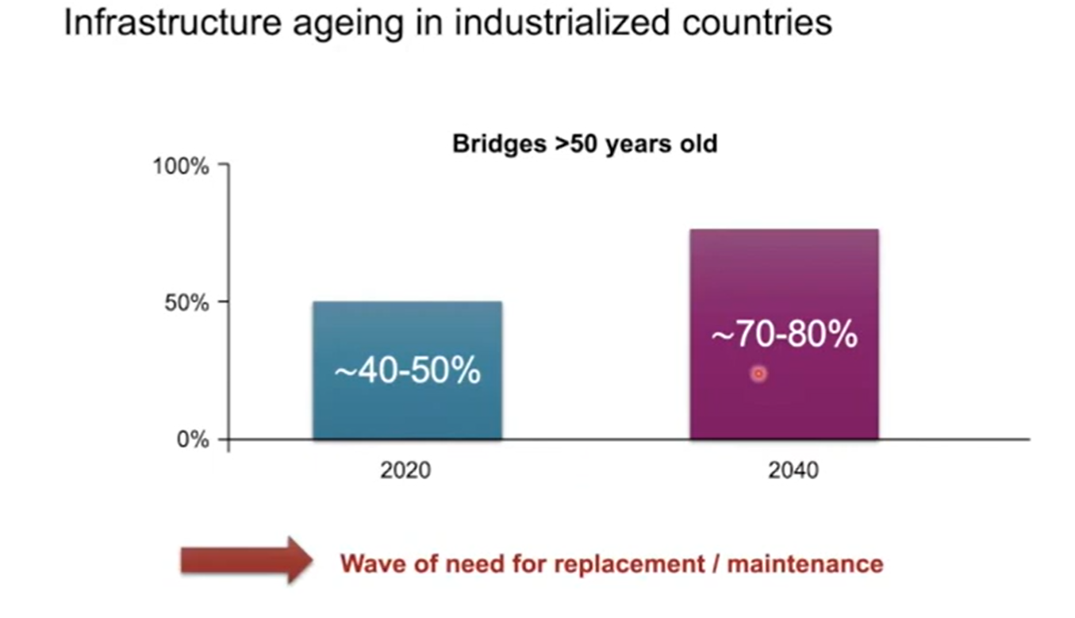

Why Chloride-Induced Corrosion is Important?
Ref: Prof. Ueli Angst
Engineering Materials Research Lab, ETH Zurich

Slide 6

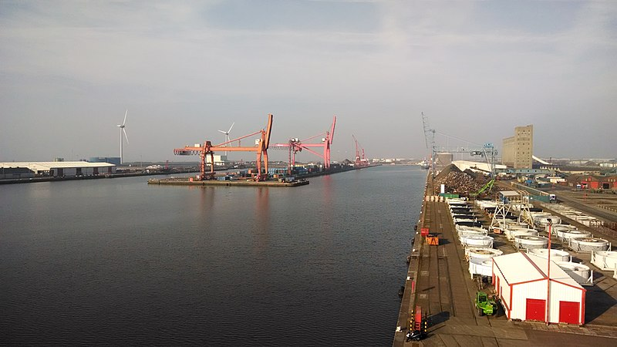

Why Chloride-Induced Corrosion is Important?
Marine structures
Roadways
Bridges
Infrastructures card 2021: Chloride-induced corrosion afflicts more than 7.5% of the concrete bridges in the United States.
Federal Highway Administration (FHWA): The cost of corrosion to concrete bridges is $10 billion/year.

Slide 7
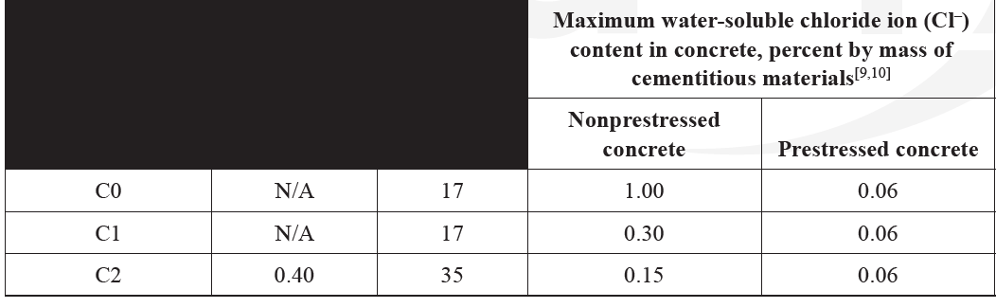
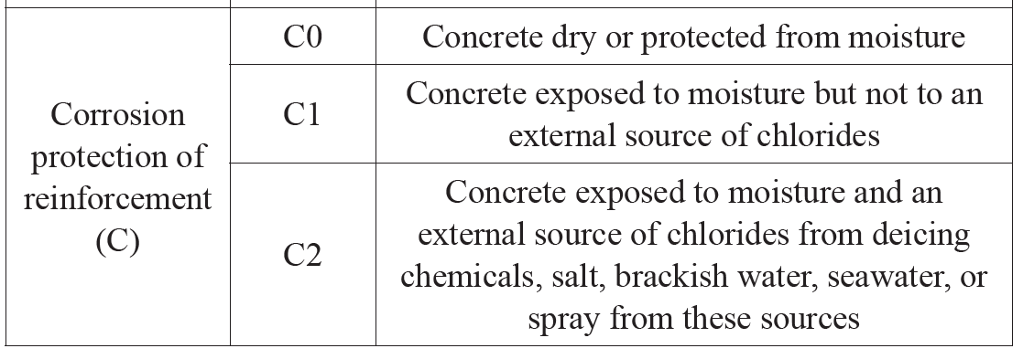
Chloride Content Limits
ACI 318 (Building code requirements for structural concrete) Table 19.3.2.1:
ASTM C1218: Standard Test Method for Water-Soluble Chloride in Mortar and Concrete
ASTM C1152: Standard Test Method for Acid-Soluble Chloride in Mortar and Concrete

Slide 8
What Are Main Sources of Chloride?
Ocean water
Soils
Deicing salts
Admixtures
What Are Popular Measures to Prevent the Chloride Induced Corrosion?
Reducing permeability
Increasing the cover
Concrete coating
Corrosion inhibitors
The list goes on!

Slide 9
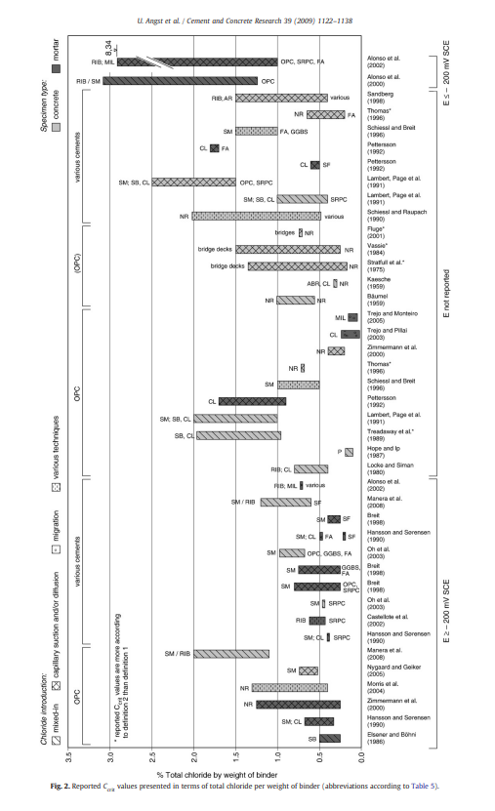
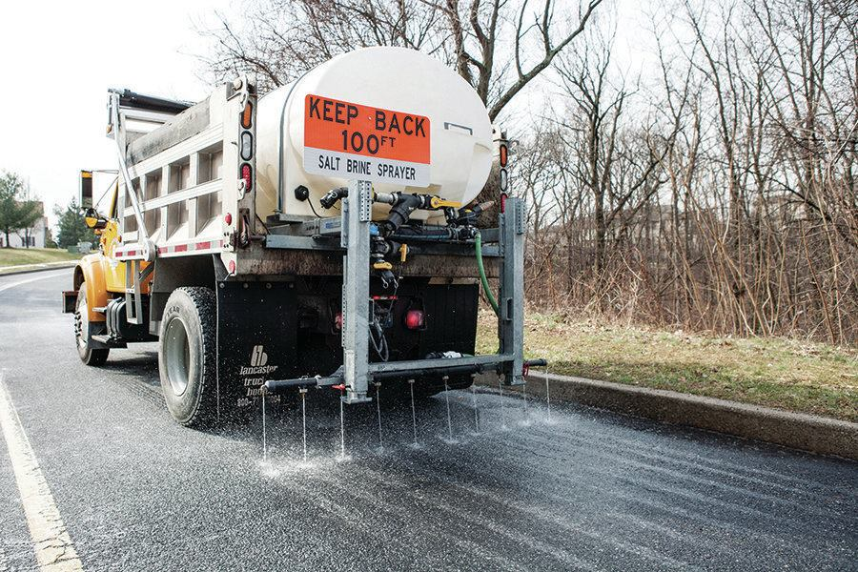
Chloride-Induced Corrosion
When a sufficient concentration of chlorides reaches the surface of the embedded reinforcing bars, chloride-induced corrosion is initiated.
Cl⁻
Cl⁻
Cl⁻
Cl⁻
Cl⁻
Cl⁻
Cl⁻
Cl⁻
Cl⁻
Cl⁻
Cl⁻
Cl⁻
Cl⁻
Cl⁻
Cl⁻
Cl⁻
Cl⁻
Cl⁻
Cl⁻
Cl⁻
Cl⁻
https://doi.org/10.1016/j.cemconres.2009.08.006

Slide 10

What Is Chloride Binding?
Chloride ions have the ability to be physically adsorbed onto the surface of cement hydrates, particularly calcium silicate hydrate (C–S–H). Additionally, they can chemically bind with tricalcium aluminate (C3A= 3CaO.Al2O3) to form a compound known as Friedel’s salt.
Friedel's salt (C3A.CaCl2.10H2O) plays a main role in the binding and retention of chloride anions in cement and concrete.
Cl
Cl
Cl
Free
Cl
Cl
Cl
Cl
Cl
Cl
Cl
Cl
Cl
Cl
Cl
Cl
Physically-Bound
Cl
Cl
Cl
Cl
Cl
Cl
Cl
Cl
Chemically-Bound
Cl

Slide 11
Dissociation of Bound Chloride
Chloride binding is a reversible process, and bound chlorides can be released to their free state in the pore solution if the pH of the concrete pore solution falls below 12 (Tang et al. 2011, Teymouri et al. 2021).
Carbonation
Sulfate attack
Acid attack
Cl
Cl
Cl
Free
Cl
Cl
Cl
Cl
Cl
Cl
Cl
Cl
Cl
Cl
Cl
Physically-Bound
Cl
Cl
Cl
Cl
Cl
Cl
Cl
Cl
Cl
Cl
Cl
Cl
Cl
Cl
Cl
Cl
Cl
Chemically-Bound
Cl

Slide 12

Dissociation of Bound Chloride
What is dissociation of bound chloride (chloride desorption)? The process by which the chlorides separate from the concrete matrix and become free ions in the pore water within the concrete.
CO₂
Cl⁻
Cl⁻
Cl⁻
Cl⁻
Cl⁻
pH ~ 9
Cl⁻
Cl⁻
Cl⁻
Cl⁻
Cl⁻
Cl⁻
Cl⁻
Cl⁻
Cl⁻
Cl⁻
Cl⁻
Cl⁻
Cl⁻
Cl⁻
Cl⁻
Cl⁻
Cl⁻
Cl⁻
Cl⁻
Cl⁻
Cl⁻
Cl⁻
Cl⁻
Cl⁻
Cl⁻
Cl⁻

Slide 13
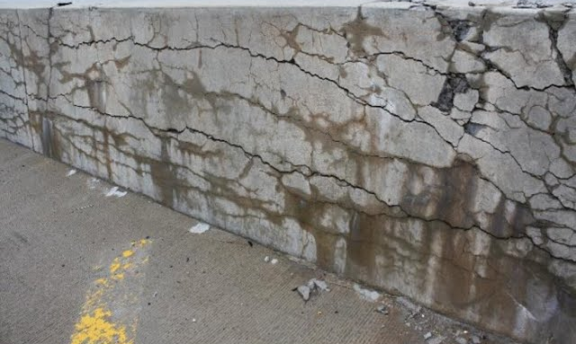

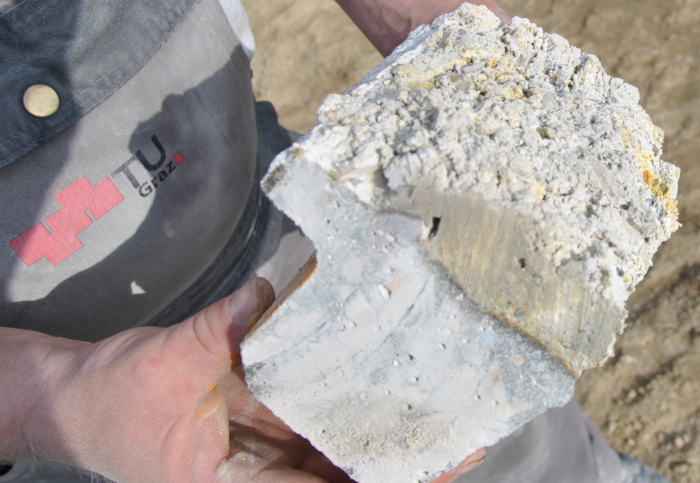
Common Types of Concrete Deterioration
Carbonation
Atmospheric carbon dioxide (CO₂) penetrates concrete, reacting with calcium hydroxide, forming carbonic acid (H₂CO₃).
Sulfate attack
Sulfate ions can originate from seawater, soil, groundwater, and industrial wastes, they react with calcium hydroxide, forming ettringite, causing expansion and cracks.
Acid attack
Acid attacks on cementitious materials comprise several complicated processes and usually lead to a sharp pH reduction, resulting in the dissolution and decomposition of hydrated phases.

Slide 14
Chloride Desorption
Unfavorable mechanism
Increased risk of corrosion
Chloride desorption neglected in service life models
Insufficiently researched

Slide 15

Knowledge Gaps
Limited knowledge of chlorides desorption in cementitious systems
Need for standardizing chloride binding tests
Chloride desorption in cement exposed to commercial de-icing brine solutions containing corrosion inhibitors

Slide 16


Literature Review

Slide 17

Research Questions
1- What is the chloride binding and desorption capacity of Portland cement concrete exposed to three common brine solutions, NaCl, CaCl2, and MgCl2?
2- How do the chloride binding capacity and desorption of cementitious systems containing slag, fly ash, and silica fume vary when exposed to brine solutions?

Slide 18

Objectives
Objective 1: Investigate the chloride binding capacity and desorption for cementitious systems containing SCMs
Objective 2: Assess impacts of pH reduction on chloride disassociation

Slide 19
Methodology
Investigate chloride binding capacity and desorption of SCMs
Cementitious Materials
Salt Solution and Concentration
Samples Preparation
Chloride Measurement Tests
Analytical test
Portland cement Type I/II
ASTM C150
NaCl (0.1, 0.3, 0.5, 0.7, 1, and 2 Molar)
Disk-shaped molds
Chloride binding after 14 days
XRD
CaCl2 (0.1, 0.3, 0.5, 0.7, 1, and 2 Molar)
Water to cement ratio = 0.4
Reduction of pH (by adding five volumes of 1 m nitric acid)
TGA
Class F fly ash ASTM C618
MgCl2 (0.1, 0.3, 0.5, 0.7, 1, and 2 Molar)
56 days sealed-cured inside the environmental chamber
Chloride desorption 14 days after p reduction
pH monitoring
Ground granulated blast-furnace slag ASTM C989
Visual observation (using microscope)
Silica fume
ASTM C1240

Slide 20
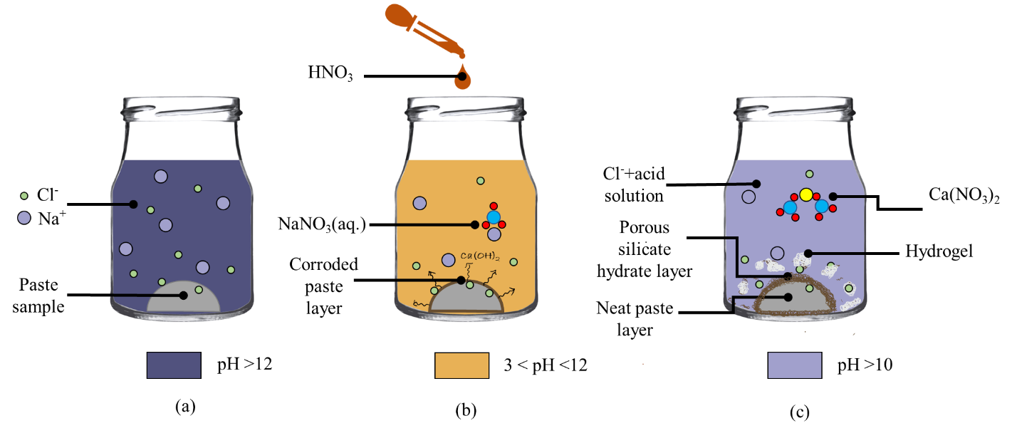
Methodology: Sample preparation
Cast in disk-shaped molds (diameter of 33 mm and depth of 15 mm)
Cured at an environmental chamber maintained at 25°C and RH of 95% for 56 days
Dried in a vacuum oven at 55℃ to obtain a constant weight
ID | Cement % | SCM type | Replacement level (%)
OPC | 100 | None | 0
FA 15 | 85 | Fly ash | 15
FA 30 | 70 | Fly ash | 30
SG 25 | 75 | Slag | 25
SG 50 | 50 | Slag | 50
SF 5 | 95 | Silica fume | 5
SF 10 | 90 | Silica fume | 10

Slide 21
Methodology: Materials
Powders: Portland cement and three most common SCMs
 | SiO₂ | Al₂O₃ | Fe₂O₃ | CaO | MgO | SO₃ | Na₂O | K₂O | LOI
OPC | 19.24 | 3.80 | 2.75 | 59.05 | 1.5 | 2.49 | 0.17 | 0.60 | 9.90
Fly ash | 54.24 | 18.16 | 10.42 | 7.37 | 1.46 | 1.30 | 1.24 | 2.71 | 1.13
Slag | 31.40 | 15.70 | 0.40 | 37.70 | 8.60 | 2.50 | – | – | 0.60
Silica | 95.40 | 0.90 | 1.30 | 0.90 | 1.40 | – | – | – | 1.70
Reagent-grade solids
NaCl: The most commonly used deicer
CaCl₂
MgCl₂
HNO3:1 M nitric acid solutions was used to reduce pH and simulate the pH reduction.
*According to the Federal Highway Administration, calcium chloride (CaCl2) and magnesium chloride (MgCl2) are recommended deicing agents for highway surfaces and are commonly used in snow and ice management practices.

Slide 22
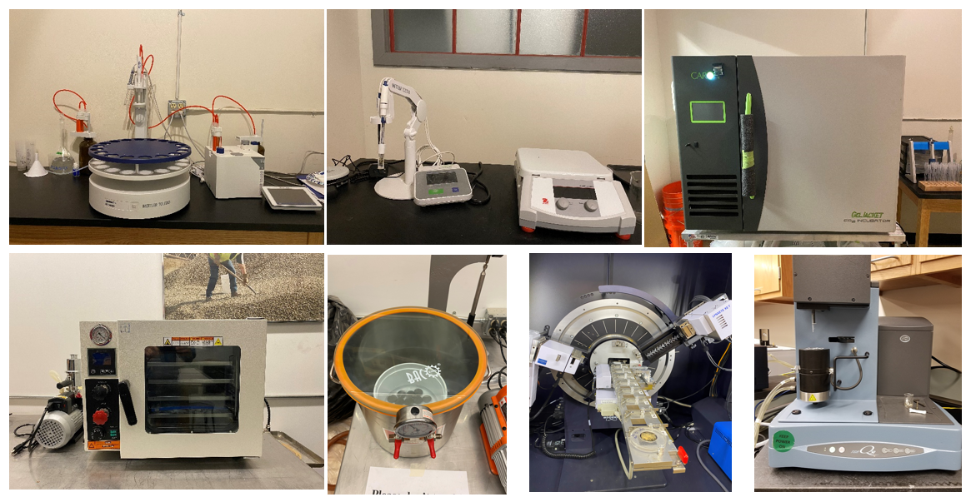
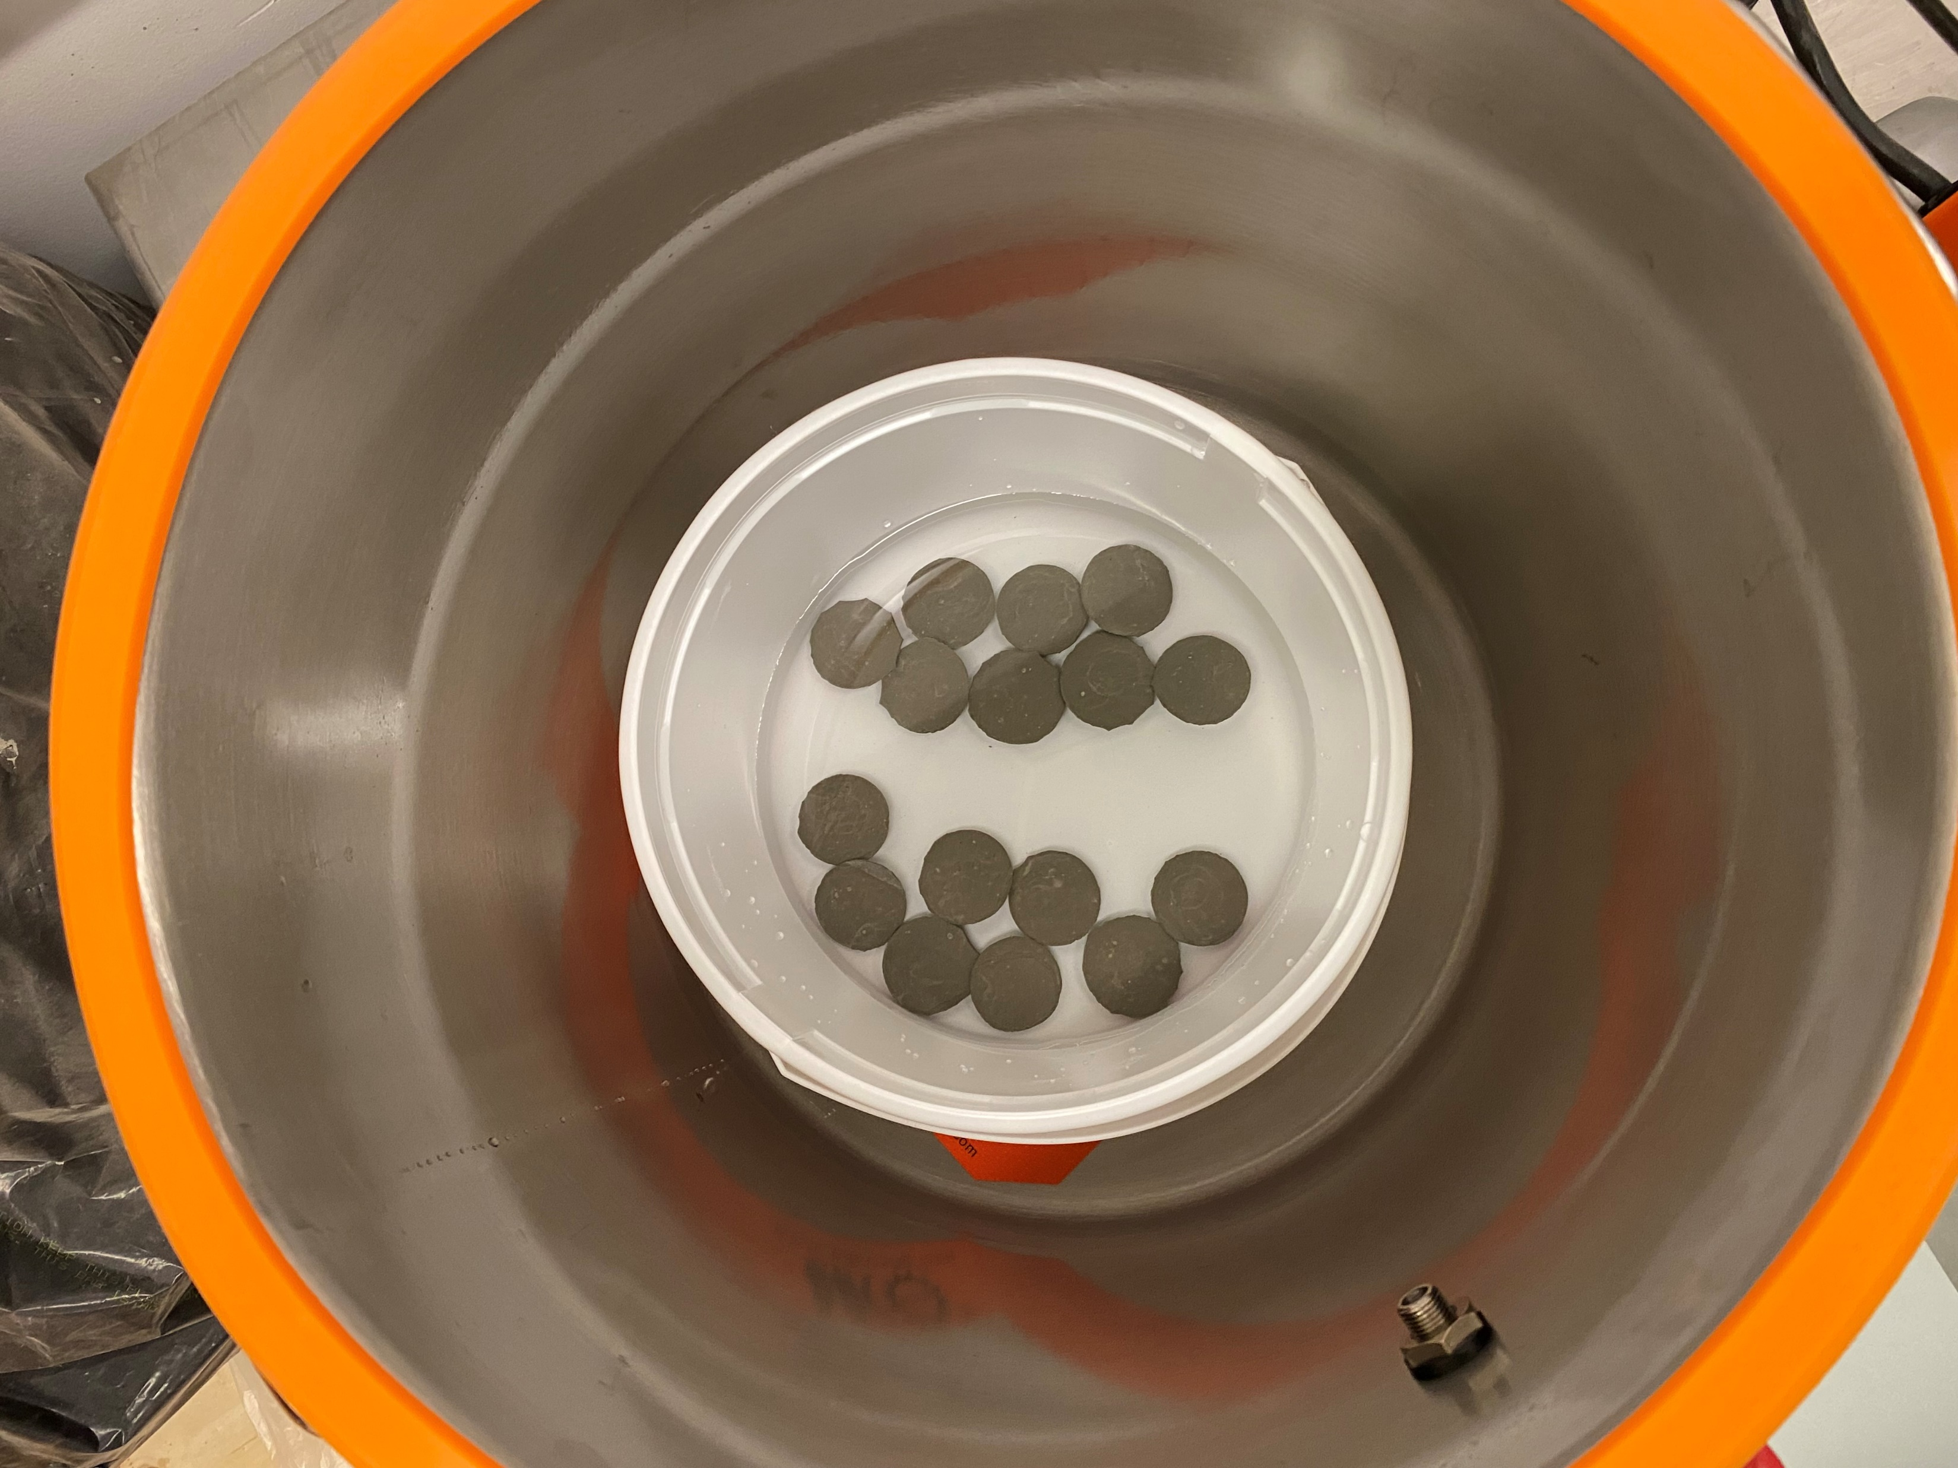
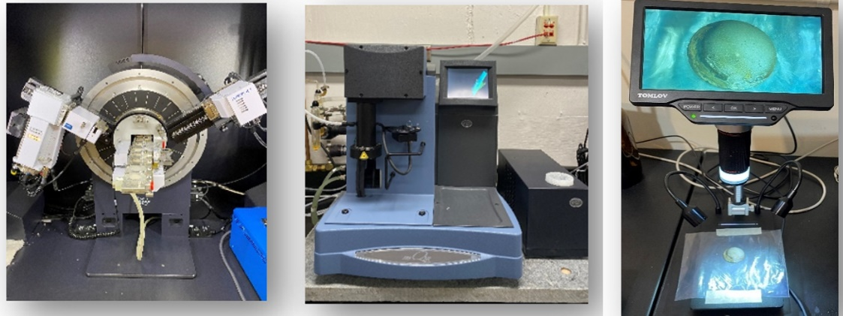
Methodology: Equipment
Titrator
pH Meter
Environmental Chamber
Pastes
Microscope
Vacuum Oven
XRD
TGA

Slide 23

Methodology: Analytical Tests
-X-ray diffraction (XRD)
Bruker D8 Discover DaVinci
Tube functions at voltage of 40 kV and a current of 40 mA
Diffraction patterns are recorded in the 2θ range of 10°–70°
analyzed using the Bruker DIFFRAC EVA software (version 5.1.0.5)
-Thermogravimetry Analysis (TGA)
Q500 Thermogravimetric Analyzer (TA Instruments)
In a nitrogen gas atmosphere
At temperatures of 50–500°C and a heating rate of 20°C/min
-Visual Inspection
A digital microscope (DM9, Tomolov)
Paraments &
Interpretation

Slide 24
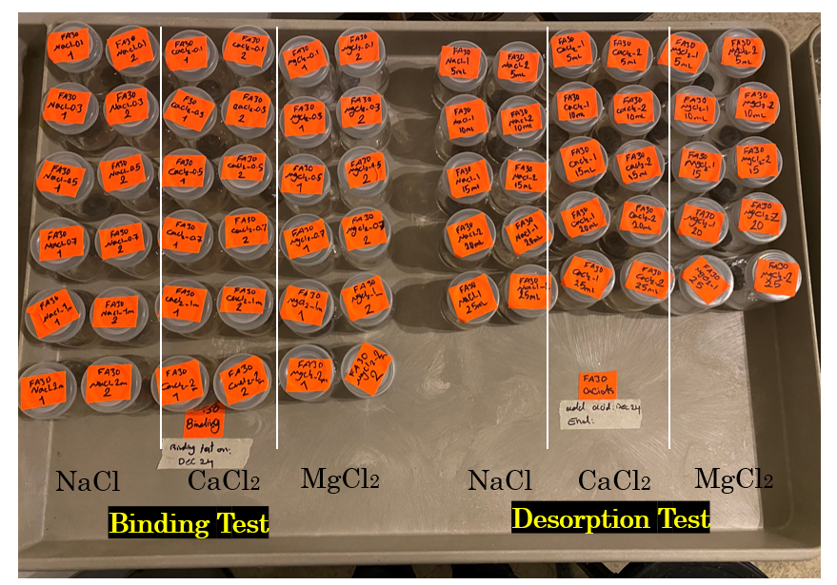
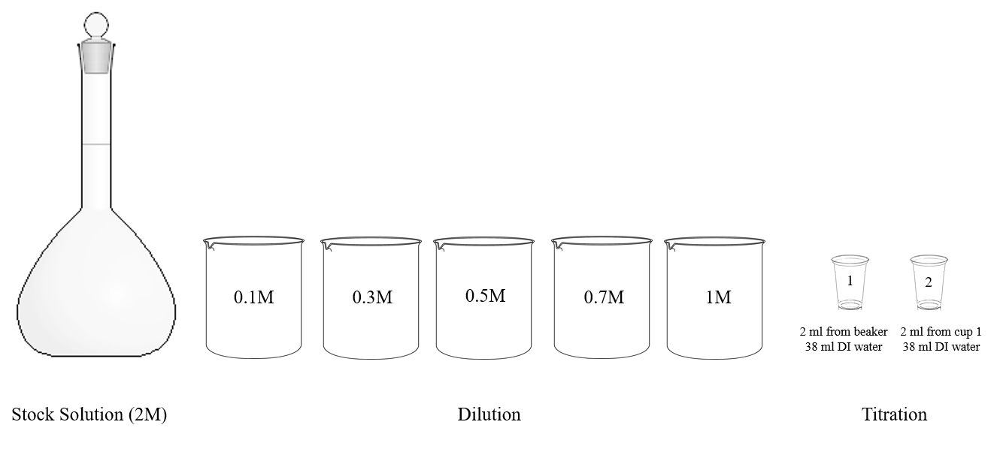
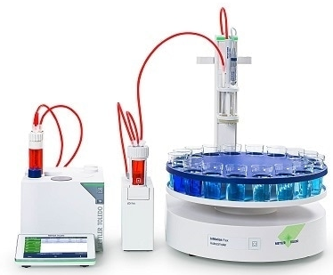
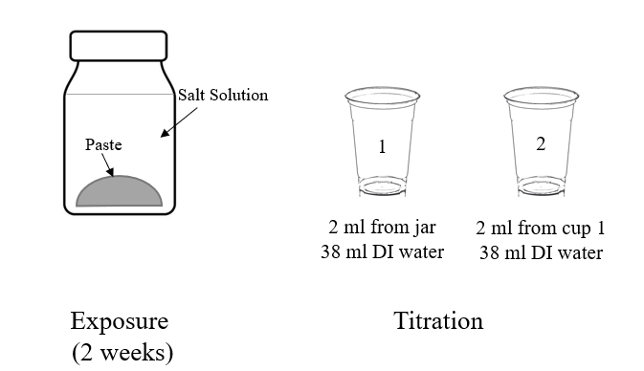
Methodology: Chloride Binding
Salt Type
NaCl
CaCl₂
MgCl₂
Apex
Titration
Result
Preparing exposure solutions
C_{i} (mol/l)
2M
Chloride binding
60 ml
chloride solution
C_{f} (mol/l)
14 days exposure
X2 replicates
Bound Chlorides =
(mg Cl/ g paste)
24

Slide 25

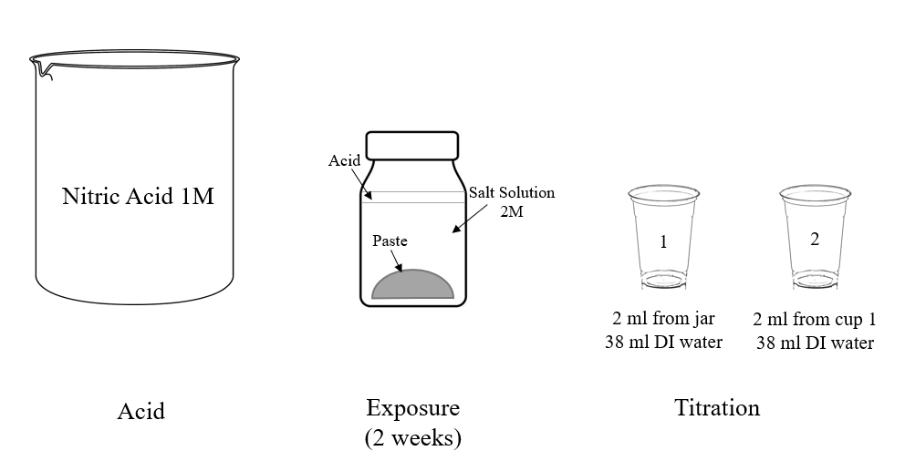
Methodology: Chloride Desorption
Chloride Binding
pH Measurement
Titration
Result
60 ml
chloride solution
C_{f} (mol/l)
Two weeks exposure to salt solution
Chloride Desorption
C_{d} (mol/l)
+5 ml HNO₃
+10 ml HNO₃
+15 ml HNO₃
+20 ml HNO₃
+25 ml HNO₃
Two weeks exposure to acid + salt solution

Slide 26
Results: Chloride Binding
OPC
Slag 25%
Slag 50%

Slide 27
Results: Chloride Binding
Which solutions had the lowest and highest chloride binding capacity?
MgCl2 showed higher binding, in the decreasing order of MgCl2> CaCl2> NaCl.
pH of brine solution (NaCl has pH of >12 ) which impacts the solubility of Friedel's salt (chemical chloride binding) formation compared to CaCl2 and MgCl2.
Ca in CaCl2 increase Ca/Si ratio in C-S-H, enhancing binding of chloride.
Exposure to MgCl2 resulted in formation of M-S-H, increasing porosity of the pastes.

Slide 28
Results: Chloride Binding
Which pastes had the lowest and highest chloride binding capacity?
Slag is most favorable, in the decreasing order of slag50% > slag25% > OPC.
The formation of more C-S-H
Presence of higher Al2O3 leading to formation of higher Afm.
The formation of higher Friedel's salt.

Slide 29
Results: Phase Composition Before Exposure
XRD
TGA
The XRD patterns of hydrated pastes. (b) Mass loss and DTG curves of hydrated pastes (E: Ettringite, C: C4AF, M: Monocarbonate, F: Ferrite, CH: portlandite, Cc: Calcite, C2S: Belite ).

Slide 30
Results: Phase Composition After Exposure to Brine Solutions
OPC
SG25%
SG50%

Slide 31
Results: Phase Composition After Exposure to Brine Solutions
OPC
SG25%
SG50%

Slide 32
Results: Phase Composition After Exposure to Brine Solutions
The mass fraction of Friedel’s salt in paste samples:
m_{Fs} is the mass fraction of Friedel's salt
m_{H2O} is the mass loss (wt. %) of the main layer of water obtained from the TGA test,
M_{FS} molar mass of Friedel's salt
(561.3 g/mol)
M_{H2O} molar mass of water
(18.02 g/mol)

Slide 33
Results: Evolution of pH after adding different volumes of acid
NaCl
CaCl2
MgCl2
For a fully carbonated concrete, the pH range is around 9.
Lower than that barley can be found in the real case scenarios!

Slide 34
Results: XRD & TGA (Before Exposure to Salt Solutions)
The incorporation of slag resulted in the highest amount of Friedel’s salt among the all binders.
SG25%
SG50%

Slide 35
Results: Chloride Desorption
The amount of measured free chloride after pH reduction increased compared to the samples without acid, regardless of binder and cation types.
Na
Ca
Mg

Slide 36
Results: Chloride Desorption
Percentage of released bound chloride: The bound chloride content before acid addition was compared to those measured after adding acid.
NaCl
CaCl2
MgCl2
OPC
90% 92% 86%
Slag
SG25: 90% 83% 71%
SG50: 90% 72% 58%
Release of bound chloride at pH=9

Slide 37
Results: Visual Inspection

Slide 38
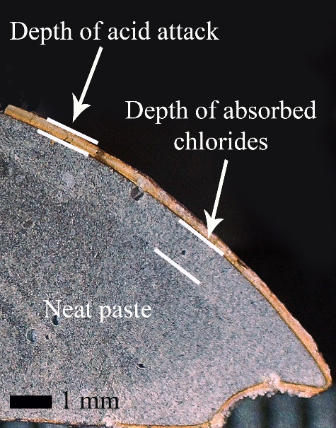
Results: influence of GGBFS on pH, chloride binding, and desorption

Slide 39
Conclusion
Chloride desorption phenomenon should be considered in the service life modelling of concrete structure.
Incorporation of slag inhibited chloride desorption and led to the retention of more bound chlorides when the pH decreased.
Increased slag replacement levels reduced the released bound chloride percentage, particularly in MgCl2 and CaCl2 solutions compared to OPC.
The chloride desorption in blended pastes was influenced by the cation in the order
Mg > Ca > Na.

Slide 40
Limitation of Study
Using pure salt solutions
Using dried paste samples
Ongoing Work
Commercial brine solutions
Wet–dry or freeze-thaw cycles
Incorporating corrosion inhibitors

Slide 41
Main References
1- Avet, F., and Scrivener, K. (2020). "Influence of pH on the chloride binding capacity of Limestone Calcined Clay Cements (LC3)" Cement and Concrete Research, 131, 106031.
2- Chang, H. (2017). "Chloride binding capacity of pastes influenced by carbonation under three conditions" Cement and Concrete Composites, 84, 1-9.
3- Chu, H., Wang, T., Guo, M.-Z., Zhu, Z., Jiang, L., Pan, C., and Liu, T. (2019a). "Effect of stray current on stability of bound chlorides in chloride and sulfate coexistence environment" Construction and Building Materials, 194, 247-256.
4- De Weerdt, K., Colombo, A., Coppola, L., Justnes, H., and Geiker, M. R. (2015). "Impact of the associated cation on chloride binding of Portland cement paste" Cement and Concrete Research, 68, 196-202.
5- Zhu, Q., Jiang, L., Chen, Y., Xu, J., and Mo, L. (2012). "Effect of chloride salt type on chloride binding behavior of concrete" Construction and Building Materials, 37, 512-517.
6- Teymouri, M., Shakouri, M., and Vaddey, N. P. (2021). "pH-dependent chloride desorption isotherms of Portland cement paste" Construction and Building Materials, 312, 125415.

Slide 42

Acknowledgment
The American Concrete Institute Foundation supported this research under grant number P0042.
We thank our advisory team and ACI-365 committee members for endorsing this project.
Thanks to the Slag Cement Association for the opportunity.

Slide 43



Thanks For Listening!
Questions?
Teymouri@colostate.edu
Paper 1
Paper 2

